Slide 2
Docker
Separate your applications from your infrastructure so you can deliver software quickly
Docker provides the ability to package and run an application in a loosely isolated environment called a container

Slide 3
Docker provides tooling and a platform to manage the lifecycle of your containers:
Develop your application and its supporting components using containers.
The container becomes the unit for distributing and testing your application.
When you’re ready, deploy your application into your production environment, as a container or an orchestrated service. This works the same whether your production environment is a local data center, a cloud provider, or a hybrid of the two.

Slide 4
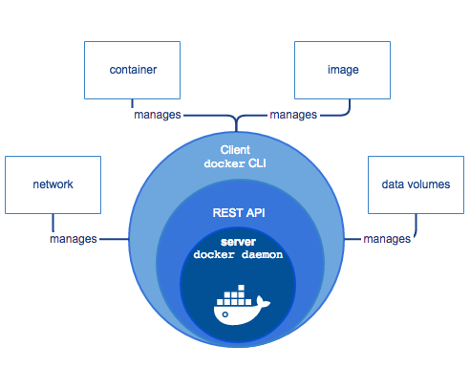
Docker Engine
Docker Engine is a client-server application with these major components:
A server which is a type of long-running program called a daemon process (the dockerd command).
A REST API which specifies interfaces that programs can use to talk to the daemon and instruct it what to do.
A command line interface (CLI) client (the docker command).

Slide 5
What can I use Docker for?
Fast, consistent delivery of your applications
Responsive deployment and scaling
Running more workloads on the same hardware

Slide 6
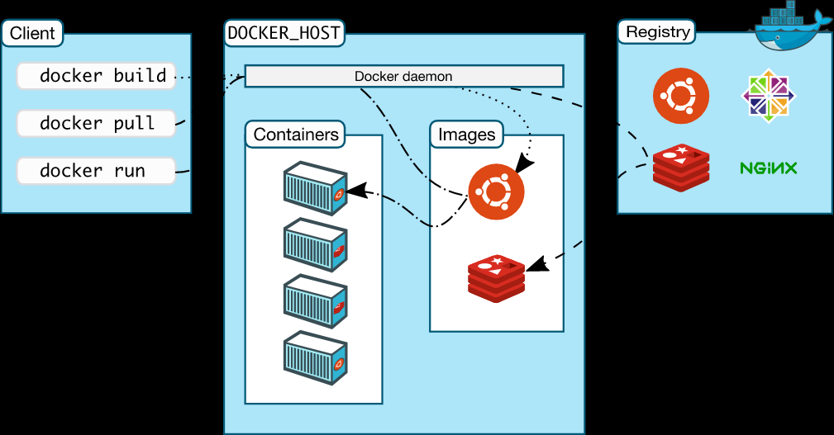
Docker architecture
client-server architecture
Docker deamon – building, running and distributing docker containers
Both can run on same or with a remote docker deamon
Communicate using REST API over UNIX sockets or network interface

Slide 7
Docker architecture
Docker Deamon [dockerd]
Listen for Docker API requests and managers docker objects such as images, containers, networks and volumes
Communicate with other deamons to mangage docker services
Docker Client [docker]
Primary way to interact with docker
Commands are sent to one or more dockerd
docker command uses Docker API
Docker registries [docker pull/run/push]
Stores docker images
Docker hub is public that anyone can use - docker looks in docker hub by default
Can run private registry

Slide 8
Docker objects
Images
Read-only template with instructions for creating docker container
Often based on another image
Use your own or published by others in registry
Dockerfile with simple syntax for defining the steps to create and run image
Each instruction creates a layer in the image
Only changed layers are rebuilt – lightweight, small and fast when compared to virtualization
Containers
Runnable instance of an image
Create, start, stop, move or delete using Docker API or CLI
Connect to one or more networks, attach storage, create new image based on current state
default - relatively well isolated from other container and its host machine
Defined by its image and configuration options
State not stored in persistent store is lost when container is removed

Slide 9
Docker objects
Containers [Example]
docker run -I -t ubuntu /bin/bash
Pulls image if not available locally
Docker creates container
Docker allocates read-write filesystem as containers final layer
Docker creates a network interface to connect the container to default network
Docker starts the container and executes /bin/bash
‘exit’ will terminate /bin/bash command, stops container but won’t remove it
Services
Scale containers across multiple docker deamons – work together as a swarm with multiple managers and workers
All daemons communicate using Docker API
Allows to define desired state – number of replicas at any given time
Default load balanced
Appears as a single application
Supports swarm mode in 1.12 or higher

Slide 10
The Underlying Technology
Docker is written in Go – takes advantage of features of Linux
Namespaces [namespaces]
Provide isolated workspace called container
Run a container – Docker creates a setup of namespaces for the container
Provide a layer of isolation
Each aspect of container run in a separate namespace and access is limited to the namespace
Docker Engine uses namespaces such as the following on Linux:
The pid namespace: Process isolation (PID: Process ID).
The net namespace: Managing network interfaces (NET: Networking).
The ipc namespace: Managing access to IPC resources (IPC: InterProcess Communication).
The mnt namespace: Managing filesystem mount points (MNT: Mount).
The uts namespace: Isolating kernel and version identifiers. (UTS: Unix Timesharing System).

Slide 11
The Underlying Technology
Control Groups [cgroups]
Limits a application to a specific set of resources
Share available hardware – optionally enforce limits and constraints ex: memory
Union File Systems [UnionFS]
File systems that operate by creating layers making them light weight and fast
Used to provide building blocks for containers
Docker engine can use multiple variants of UnionFS – AUFS, btrfs, vfs and DeviceMapper
Container Format
Combination of namespaces, control groups and UnionFS into a wrapper
default: libcontainer
In future may support other formats integrating with technologies such as BSD Jails or Solaris Zones

